Slide 1
Factors affecting acceptance and use of interactive whiteboards
Boštjan Šumak, Maja Pušnik
Institute of Informatics,
Faculty of Electrical Engineering and Computer Science,
University of Maribor, Maribor, Slovenia
bostjan.sumak@um.si

Slide 2
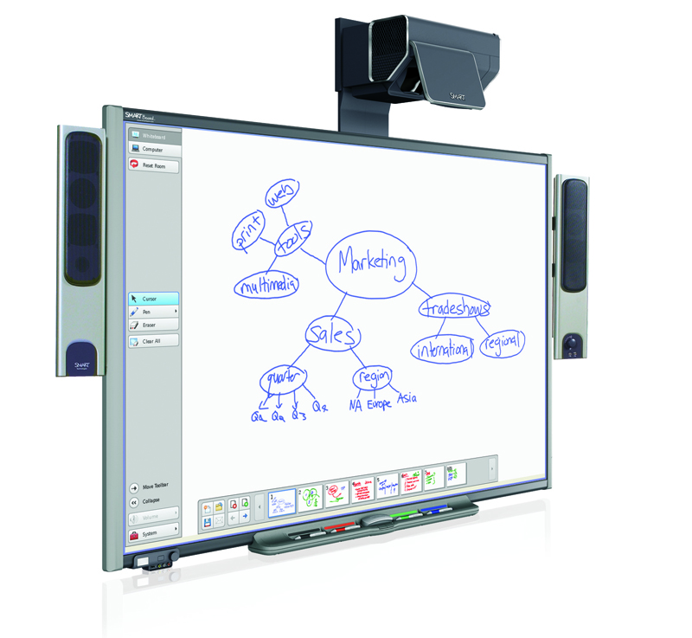

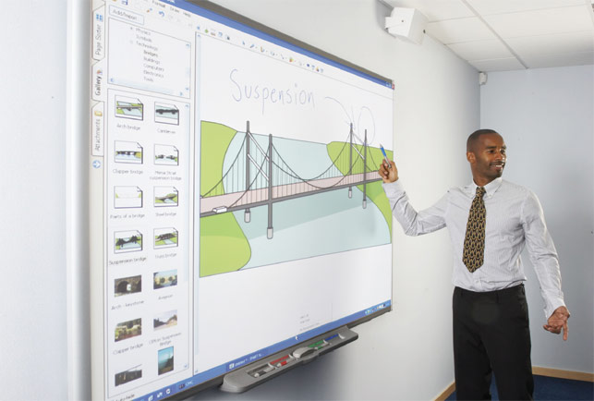
Interactive WhiteBoard (iWB)
Computer + Projector + Touch-sensitive board
  A projector projects the computer's desktop onto the board's surface where users control the computer using a pen, finger, stylus, or other device.
Can be adapted for use with a wide range of subjects and ages.
  classrooms,
  corporate board rooms and work groups,
  training rooms,
  etc.
Functions of a regular board + additional unique functionalities that enable interactive learning & teaching
  Drag&Drop, highlighting, animation, etc.
Notes:
A technology made up of a computer connected to a projector and a touch-sensitive board that presents the pictures projected from the computer, allows for changes, and receives input electronically or by touch.

Slide 3
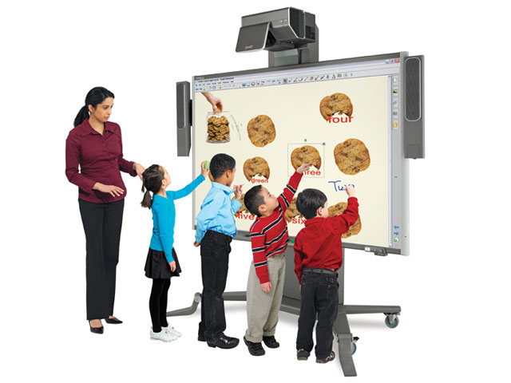
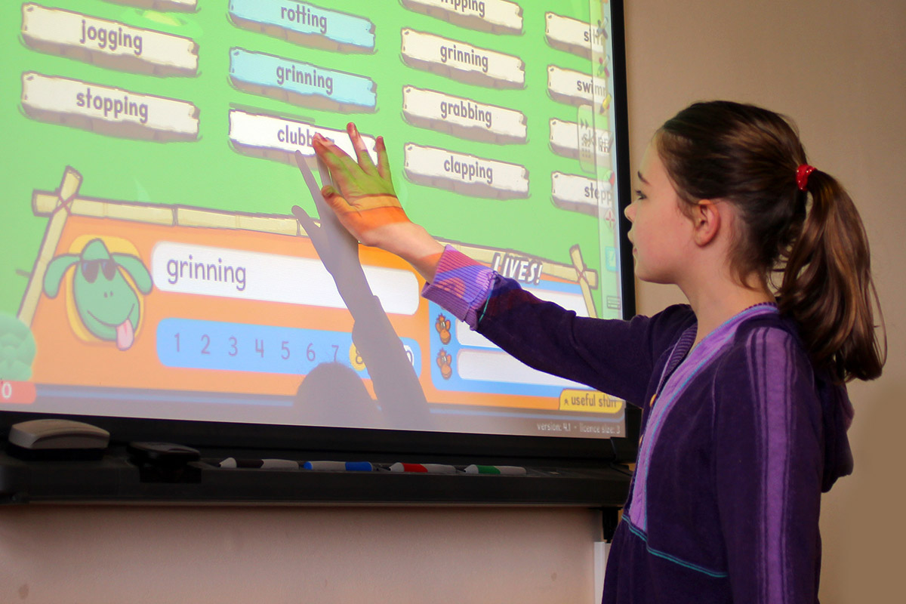
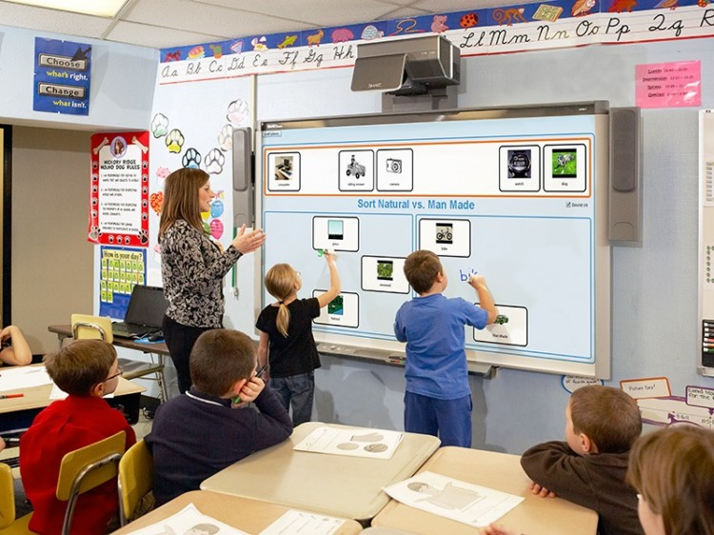
iWB’s benefits
Traditional classroom environment →
student-centered interactive collaborative environment:
  Interactive collaboration, lesson participation and problem solving,
  Idea-sharing, brainstorming, group discussion,
  Instant access to a vast electronic resources (eg. multimedia lessons and presentations),
  Virtual field trips and show cases,
  Interactive games based learning,
  Ability to save and post content on the board,
  etc.
A colorful tool that can increase students‘ attention, motivation, participation and collaboration
Notes:
Current research on the IWB use in educational settings, while limited, demonstrate IWB’s potential benefits to teaching, such as flexibility, versatility, multimedia ability, efficiency, interactivity, lesson participation, collaboration, idea-sharing, motivation, instant access to a vast electronic resources, and the ability to save and post drawings and writings on the board (Levy, 2002 and Smith et al., 2005). With the benefits listed above, IWBs can be a powerful technological aid to help teachers transform the traditional classroom environment into a student-centered collaborative environment.
The interactive electronic whiteboard is great for demonstrations. In the survey, many technology teachers and specialists reported enthusiasm for the board in staff development or computer class to show students how to use a particular application. Because the presenter can run the application from the board, using his finger like a mouse, it is easy to show the important features of particular software. The ability to mark on the board by writing with the stylus or using one's finger makes it possible to point out important features of the program.
The interactive electronic whiteboard is a colorful tool. Research indicates that students respond to displays where color is employed, and marking can be customized both in the pen and in the highlighter features to display a number of different colors. Width of lines can also be adjusted to add flexible marking choices.
The board can accommodate different learning styles. Tactile learners can benefit from touching and marking at the board, audio learners can have the class discussion, visual learners can see what is taking place as it develops at the board.
All ages of students respond favorably to board use. Interactive whiteboards were originally used in the business world for group meetings. As they have gained popularity in schools, teachers have reported success with the youngest learners through students in academic settings. My present use of the board for demonstrations with graduate library science students has been as satisfying as my previous use with junior high learners.
Distance learning is an excellent setting for interactive whiteboard use. Since they can be connected for distance communication, they have value to users at more than one site concurrently.
One-computer classrooms can maximize the use of limited computer access by using the whiteboard. Students can work together with individuals contributing at the board, other participants at the computer, and the group as a whole discussing the activity. While it is true that acquiring the board and the projector is an expense, the use of this set-up can be viewed as a cost-cutter when it makes it possible for one computer to serve multiple students.
The interactive whiteboard is an excellent tool for the constructivist educator. Author David Johassen coined the word "mindtool" to describe devices or applications which encourage use of technology to encourage critical thinking in students. Attributes of mindtools include ease of use, group interaction, ready availability of software to be used. Since the boards can be used with any software, they are extremely adaptable for numerous uses and do not require acquisition of additional software. Their creative use is limited only by the imaginations of teachers and students.
The boards are clean and attractive tools. There is no messy chalk dust or other by-product, which can limit use. While the board can be used with regular dry erase markers, it is more likely to be used with the electronic marking feature, which employs either stylus or finger, and thus requires no cleanup.
Students with limited motor skills can enjoy board use. Because of large format, it may be easier for students to run programs by tapping on the board rather than mouse clicking. Also, teachers with young students report success having them write on the board with their fingers rather than the stylus.
It is interactive. Users can be contributing directly by input both at the computer and at the board. The combination I liked best was for the teacher to be stationed at the computer, with students at the board and in the class offering suggestions and physically contributing ideas and actions. The interaction that transpires between the person at the computer, the users at the board, and the computer itself is a unique and very adaptable arrangement.
It can interface well with other peripherals. I have used the board to display images both from a document camera and a video camera. With the document camera, the presenter can show an object such as a specimen and then mark on the board to point out features or label parts. We used the board with videotape of a sports activity, with the coach marking on the display as it occurred to show when and where players should have completed certain actions. Scanned images can also be shown to great advantage on the board and then written text added.
The board is great for meetings are lessons where the participants need printed copies of the proceedings. At the end of a brainstorming activity, for example, copies of the resulting document can be printed and distributed, as well as be saved for future work.
It is a kid magnet! I have participated in district technology fairs, PTO meetings, and other gatherings where I demonstrated use of the interactive whiteboard. Kids of all ages are drawn to the board. Adults who are first attracted by the novelty find themselves suggesting ways they could see it used effectively. Children just want to use the board at every opportunity.

Slide 4
Mixed results about the impact of iWBs on education
In existing literature several studies showed mixed conclusions about the effect of the use of iWBs
  NEGATIVE EFFECTS : POSITIVE EFFECTS
  NO LEARNING GAINS : SIGNIFICANT LEARNING GAINS
(eg. Mathematics)
  (eg. English)

Slide 5
iWBs challenges, needs & opportunities
Several studies reported IWB issues that may dramatically decrease the effectiveness of iWBs in the courses
  institutions lack of resources,
  teachers lack of time for learning,
  teachers are confronted with a flood of materials, which are not
    equipped with proper instructions, and
    supported by the pedagogical-didactic models for their effective use in the classroom
  teachers lack of ICT competency and experience on how to use iWB,
  lack of pedagogical competency on how to integrate iWB into classroom activities,
  lack of technical support,
  lack of a school plan on the use of IWBs,
  etc.

Slide 6
iWBs in Slovenia
Ministry of Education, Science and Sport has been encouraging the use of interactive tools for interactive teaching in Slovenian schools
More than 70% primary schools planned to purchase iWBs
  BUT… despite the great interest and positive attitude towards introduction of new technologies and teaching tools in the teaching process, existing research showed negative attitude towards the use of iWBs in Slovenia
Technical Problems
Lack of Education
Lack of Experience
NEGATIVE ATTITUDE TOWARD USING
Lack of Time
...
Notes:
technical problems,
lack of education,
Lack of experience
time spent by teachers when preparing interactive materials
lack of skills to effectively handling and teaching with iWBs.

Slide 7



Project
Accelerating acceptance and use of interactive content on smart devices
  Proposed solution: an online community portal/site through which teachers can share interactive content and experiences with the aim of increasing the efficiency of the use of iWBs.
A project, funded by the operation that was partly financed by the European Union through the European Social Fund.
Notes:
Z izvedbo projekta želimo tako učiteljem kot učencem približati uporabo interaktivnih vsebin in naprav.
V obstoječih raziskavah avtorji delijo mnenje, da je potrebno učitelje bolje motivirati in izobraževati na novih tehnoloških področjih, ki se navezujejo na uporabo interaktivnih tabel in interaktivnih multimedijskih vsebin.
Temelj projekta bo sistem za učenje in uporabo interaktivnih vsebin, ki bo temeljil na aktivnem sodelovanju med razvijalci projekta in končnimi uporabniki.
Sistem bo vključeval spletni portal ter mobilno aplikacijo.

Slide 8




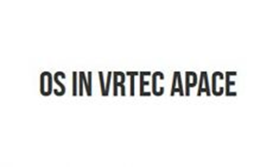
An interdisciplinary project
Students and mentors from different faculties
+ working mentors from organizations
Carried out over a period of 6 months (February – July, 2015)
Notes:
Z izvedbo projekta želimo tako učiteljem kot učencem približati uporabo interaktivnih vsebin in naprav.
V obstoječih raziskavah avtorji delijo mnenje, da je potrebno učitelje bolje motivirati in izobraževati na novih tehnoloških področjih, ki se navezujejo na uporabo interaktivnih tabel in interaktivnih multimedijskih vsebin.
Temelj projekta bo sistem za učenje in uporabo interaktivnih vsebin, ki bo temeljil na aktivnem sodelovanju med razvijalci projekta in končnimi uporabniki.
Sistem bo vključeval spletni portal ter mobilno aplikacijo.

Slide 9
Project’s objectives
To bring interactive content closer to teachers and students.
To provide online space for sharing most relevant literature.
Sharing interactive content materials.
Expressing and sharing users’ wishes and recommendations.
Encourage the use of interactive contents on smart devices.
Publish recommendations and good practices in interactive content design.
Investigate and analyse the use of interactive content.
Develop an online community site (portal).
Develop a mobile application.
Analyse factors that have significant impact of acceptance and effective use of iWBs in the classroom.
Notes:
Približati interaktivne vsebine učiteljem in učencem.
Zagotoviti prostor na katerem bo dosegljiva literatura in vse informacije o interaktivnih vsebinah.
Zagotoviti deljenje in souporabo vsebin.
Omogočati možnost izražanja želja in priporočil s strani uporabnikov.
Vzpodbujati uporabo interaktivnih gradiv in vsebin.
Zapisati priporočila in dobre prakse izdelave in oblikovanja vsebin.
Raziskati primerna orodja in metodologije za razvoj sistema.
Raziskati in analizirati uporabo interaktivnih vsebin.
V okviru raziskave uporabnosti interaktivnih vsebin povzeti in sestaviti zaključke uporabnosti, priporočil, dobrih praks, idej končnih uporabnikov, ki bodo pripomogli k kvaliteti razvoja sistema.
Izdelati spletni portal, ki bo združeval zgoraj navedene cilje.
Izdelati mobilno aplikacijo, sinhronizirano s spletnim portalom, na kateri bodo vsebine v okrnjeni obliki.
Poiskati dejavnike, ki omejujejo vpeljavo in učinkovito rabo interaktivnih tabel v razredu.

Slide 10
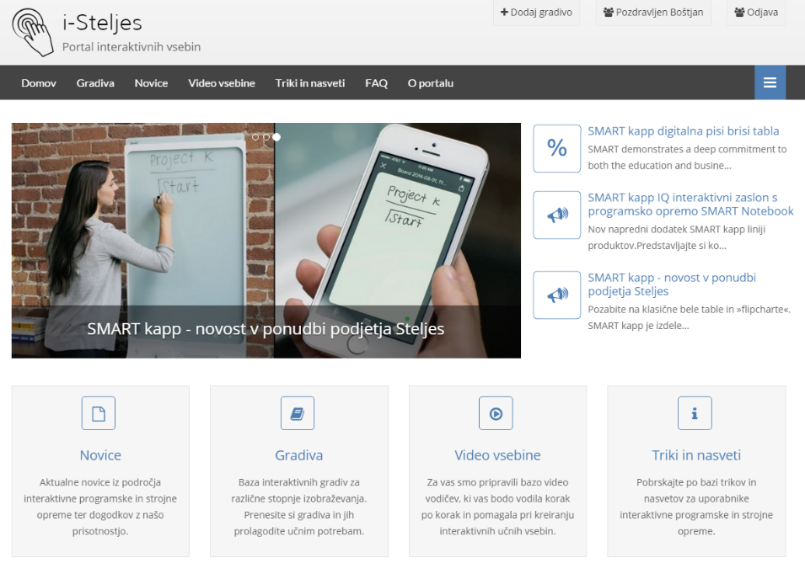
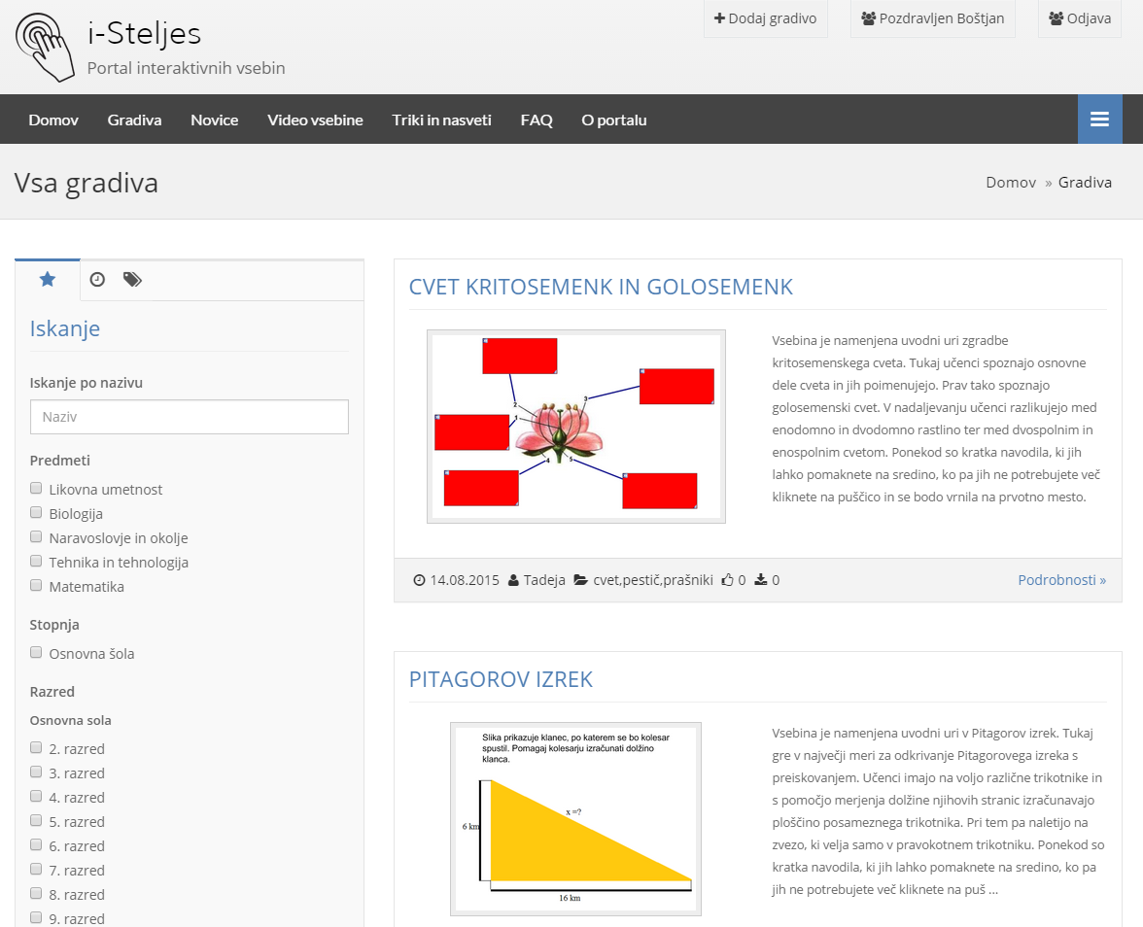
i-Steljes
http://www.i-steljes.eu/
Main objective/result of the project – an online community portal
The aim of the portal is to
  accelerate the recognition and acceptance of interactive content and devices by teachers and students
  better motivate and educate about the use of new interactive technology.

Slide 11
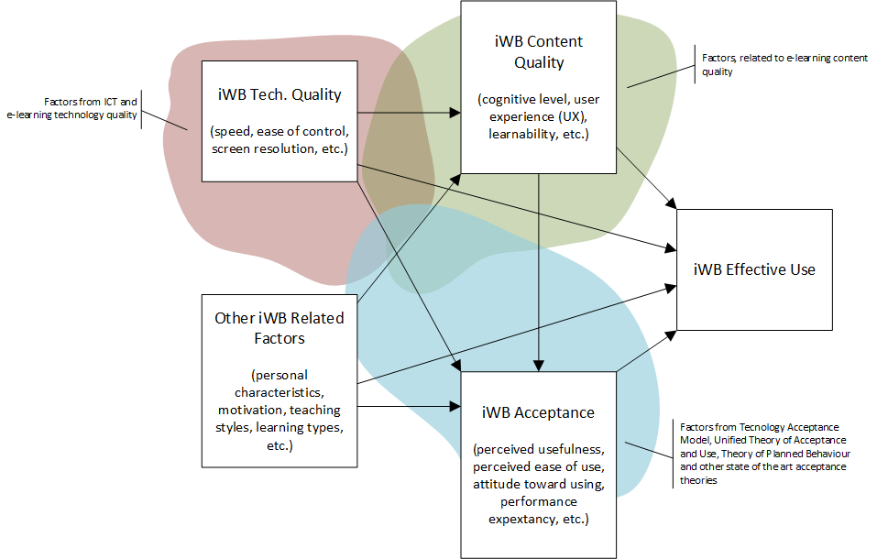
Study
Objective: to investigate factors with significant impact on user‘s decision whether he or she will accept and use iWB in a classroom for teaching purposes

Slide 12
Theoretical
Backgrounds
Oppinions
Attitudes Toward Behaviour
…
Behavioural Intention
Actual Behaviour
…
Subjective Norms
Studies, dealing with identification of factors and assessment of their impact on user’s decision whether he or she will accept and use a certain technology
Most known IT acceptance theories:
  TRA - Theory of Reasoned Action
  TAM - Technology Acceptance Model
  MM - Motivational Model
  TPB - Theory of Planned Behaviour
  MPCU - Model of PC Utilization
  IDT - Innovation Diffusion Theory
  SCT - Social Cognitive Theory
  UTAUT - Unified Theory of Acceptance and Use of Technology
Motivation
Perceived Usefulness
Perceived Ease of Use
Usage
Attitude Toward Behaviour
Perceived Enjoyment
Subjective Norms
Behaviour Intentions
Actual Behaviour
Perceived Behaviour Control
Impact
Behaviour Level
Perceived Consequences
Behaviour Intentions
Actual Behaviour
Social Factors
Facilitationg Conditions
Computer Self-Efficacy
Affect
Expected Outcome (Outcome)
Anxiety
Expected Outcome (Personal)
Usage

Slide 13
The Research Model
Tech. Quality
Factors
Content Quality
Factors
Organizational
Factors
Personal
Factors
UI Quality
Content Availability
Job Relevance
Self-Efficiency
Compatibility
Content Quality
Manag. Support
Pers. Innovatieveness
...
...
...
...
Reliability
Tutorials Quality
Help
Intrinsic motivation
Acceptance Determinants
PERFORMANCE EXPECTANCY
Behavioral Constructs
BEHAVIORAL INTENTION
Satisfaction
EFFORT EXPECTANCY
Pedagogical Impact
USE
CONTINUED USE
...
SOCIAL INFLUENCE
Perceived Enjoyment
ATTITUDE TOWARD USING
FACILITATING CONDITIONS
Pedag. Factors
Sex
Age
Voluntariness
User’s characteristics
ICT Experience
iWB Experience
...

Slide 14
Research Methodology
To test the stated causal hypotheses, a quantitative research was conducted.
An online survey (Limesurvey) was developed to collect the empirical data
  62 questions
  Demographics questions (gender, age, experience with the iWB, etc.)
  Indicators for the constructs proposed in the research model
    adapted from existing (validated) work (UTAUT constructs and other factors)
    A 7-point Likert-type scale
      answers labelled with from “strongly agree” to “strongly disagree” was used for indicators.
    To reach a certain level of balance in the questionnaire, several indicators were worded negatively.
Steps
  Pre-test (7 users – project members)
  Test (18 users)
  Final execution (still in progress!)

Slide 15

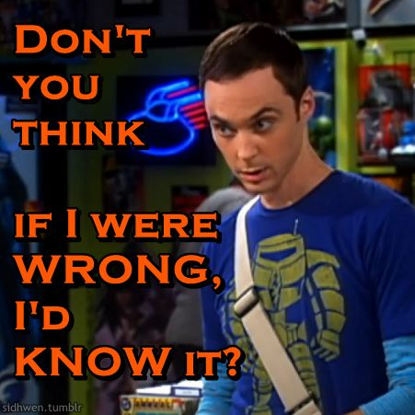
Test of the questionnaire
All teachers shared the
same opinion
18 teachers from the Primary School Apače were asked to take part in the testing phase
  2 weeks to complete the online questionnaire and
  email whatever thoughts and remarks they had about the questionnaire
  Altogether no errors were found
TOO LONG!

Slide 16
Test of the questionnaire
(constructs measures)
Variable | Cronbach α
PE1, PE2, PE3 | 0,918224
EE1, EE2, EE3, EE4 | 0,961983
FC1, FC2, FC3, FC4 | 0,976265
SI2, SI2, SI3, SI4 | 0,907387
U1, U2, U3 | 0,620098
ATU1, ATU2, ATU3, ATU4 | 0,868772
BI1, BI2, BI3, BI4 | 0,983314
CONTU1, CONTU2, CONTU3 | 0,945672
SE1, SE2, SE3, SE4 | 0,898075
PERSINOV1, PERSINOV2, PERSINOV3, PERSINOV4 | 0,832486
INMOTIV1, INMOTIV2, INMOTIV3, INMOTIV4, INMOTIV5, INMOTIV6 | 0,956968
FEELING1, FEELING2, FEELING3, FEELING4 | 0,765789
PENJOJMENT1, PENJOJMENT2, PENJOJMENT3 | 0,847384
UIQ1, UIQ2, UIQ3, UIQ4 | 0,808241
COMP1, COMP2, COMP3 | 0,964286
TECHQ1, TECHQ2, TECHQ3, TECHQ4 | 0,985720
REL1, REL2, REL3, REL4 | 0,935751
CONTAV1, CONTAV2, CONTAV3 | 0,825429
CONTQ1, CONTQ2, CONTQ3 | 0,829719
TUTA1, TUTA2, TUTA3 | 0,958590
TUTQ1, TUTQ2, TUTQ3 | 0,977642
INFOQ1, INFOQ2, INFOQ3, INFOQ4 | 0,973692
JOBREL1, JOBREL2, JOBREL3 | 0,991362
(MANSUP 1, MANSUP2, MANSUP3, MANSUP4 | 0,963869
EDUSUP1, EDUSUP2, EDUSUP3 | 0,998133
HELPUSE1, HELPUSE2, HELPUSE3 | 0,956148
SAT1, SAT2, SAT3, SAT4 | 0,985433
PEDIMP1, PEDIMP2, PEDIMP3, PEDIMP4, PEDIMP5, PEDIMP6, PEDIMP7, PEDIMP8 | 0,992936
With the exception of the construct Use, all of the estimated Cronbach’s α values for constructs from the research model exceeded the cut-off value of 0.70,
  → constructs showed a reasonable level of reliability.
According to the results of Cronbach‘s α if deleted several indicators were removed
  to reduce the extent of the questionnaire, and also
  to improve the level of reliability.

Slide 17
Final Execution (still pending)
Sample
  Teachers in primary and secondary schools
Request for participation was sent to 2k email addresses
  in the middle of June (bad timing ☹)
  So far, we got 69 complete responses (101 started the questionnaire)

Slide 18
Conclusions based on empirical data (at this point)
A typical respondent was a female, 45 – 54 years old experienced teacher (using ICT and iWB for several years) that is using iWB daily (66,7%) and/or at least weekly (24,6%)
> 50% of respondents don’t use web sites and portals for searching content, tutorials, etc. Why?
  They are not aware of such sites.
  Web sites are not in Slovenian language.
  They don‘t have time (searching, browsing).
  They prefer to prepare content by themselves and therefore they don‘t have a need for searching such sites.
Notes:
79.7% uporabnikov i-table, ki so sodelovali v anketi, je ženskega spola in 20.3% moškega spola. Polovica anketirancev (47.8%) je starih med 45 in 54 let, sledi starostna skupina 35 – 44 let (27.5%). Večina anketirancev je učiteljev s VII. stopnjo izobrazbe – visokošolski strokovni program, univerzitetni program, magisterij stroke (2. bol. stopnja), in sicer 71%. Dobra polovica uporabnikov poučuje s pomočjo i-table na predmetni stopnji OŠ (55.1%), 29% na razredni stopnji OŠ ter manjši odstotek (10.1%) v srednji šoli. Večina anketirancev uporablja i-tablo pri pedagoškem procesu prostovoljno (94.2%). Kar se tiče izkušenosti ugotavljamo, da so udeleženci ankete uporabniki z večletnimi izkušnjami, in sicer 21.7% jo uporablja več kot 2 leti, 20.3% več kot 3 leta, 8.7% več kot 4 leta ter 34.8% več kot 5 let. I-tablo pri pedagoškem procesu večina anketirancev uporablja dnevno (66.7%) ali na tedenski ravni (24.6%).
Večina uporabnikov i-table se smatra za izkušene na področju uporabe informacijsko komunikacijskih tehnologij (IKT) pri pedagoškem procesu, pri čemer jih je 44.9% mnenja, da so napredni uporabniki ter 42% takih, ki menijo, da so povprečni uporabniki. Uporabniki so podobnega mnenja glede izkušenj pri uporabi i-table pri pedagoškem procesu, kjer jih je večina izkušenih (40.6%) ali zelo izkušenih (26.1%). Kljub temu je velik odstotek takih uporabnikov, ki imajo malo izkušenj (33.%) oz. so preizkusili in uporabili le nekaj osnovnih funkcionalnosti, ki jih ponuja i-tabla.
Manj kot polovica vprašanih (44.9%) uporablja spletne portale in mesta za iskanje vsebin za i-table, vodiče, pomoč. Med razlogi, zakaj se nekateri uporabniki ne odločijo za iskanje tovrstnih vsebin na spletnih mestih so na primer: (1) uporabniki ne poznajo tovrstnih spletnih mest, (2) spletna mesta niso v slovenskem jeziku, (4) uporabniki nimajo časa za brskanje in iskanje, (3) uporabniki raje samostojno ustvarjajo vsebine in tovrstnih mest ne iščejo.
Pri pedagoškem procesu uporabniki i-tablo uporabljajo za različne vrste vsebin, pri čemer opažamo, da se še vedno več uporabljajo statične vsebine (71%). Interaktivne vsebine uporablja manj uporabnikov (58%), prav tako spletne vsebine (55%) in multimedijske vsebine (67%).

Slide 19
Some conclusions (UTAUT)
iWB is useful in the teaching process (90%).
The use of iWB allows faster completion of tasks related to the teaching process (65%)
The use of the iWB increases the productivity of the teacher (58%).
Users does not have any problems with the interaction with the iWB (79%).
62% of users agree that it is easy to become a proficient user of iWB.
It is easy to use the IWB (57%).
Notes:
Performance Expectancy
The vast majority of users considered that the iWB is useful in the teaching process (90%). Most users also consider that the use of iWB allows faster completion of tasks related to the teaching process (65%) and that the use of the iWB increases the productivity of the teacher (58%).
Effort Expectancy
Most (79%) users does not have any problems with the interaction with the iWB. 62% of users agree that it is easy to become a proficient user of iWB, and that it is easy to use the IWB (57%).
Facilitating Conditions
Despite the fact that more than half of users (45%) believe that they have all the resources they need to use iWB, a quarter of respondents do not share the same opinion. Similarly, the relationship is reflected in the field of knowledge that is needed to use iWB and additional assistance/help to which users can contact in case of problems. Most users don‘t have any problems with compatibility of the iWB with other devices and computer systems used in the teaching process.
Social Influence
Teachers generally do not use iWB because this was something that a particular person would expect them to do. However, a positive support in the use of iWB of the management of the school was observed.

Slide 20
Some conclusions (UTAUT)
Teachers generally do not use iWB because this was something that a particular person would expect them to do.
However, they get motivated by the school management
25% think they don’t have all the resources they need to use iWB effectively.
Similar results were related to the knowledge needed for effective use of iWB.
Notes:
Performance Expectancy
The vast majority of users considered that the iWB is useful in the teaching process (90%). Most users also consider that the use of iWB allows faster completion of tasks related to the teaching process (65%) and that the use of the iWB increases the productivity of the teacher (58%).
Effort Expectancy
Most (79%) users does not have any problems with the interaction with the iWB. 62% of users agree that it is easy to become a proficient user of iWB, and that it is easy to use the IWB (57%).
Facilitating Conditions
Despite the fact that more than half of users (45%) believe that they have all the resources they need to use iWB, a quarter of respondents do not share the same opinion. Similarly, the relationship is reflected in the field of knowledge that is needed to use iWB and additional assistance/help to which users can contact in case of problems. Most users don‘t have any problems with compatibility of the iWB with other devices and computer systems used in the teaching process.
Social Influence
Teachers generally do not use iWB because this was something that a particular person would expect them to do. However, a positive support in the use of iWB of the management of the school was observed.
Pričakovan učinek
Velika večina uporabnikov je mnenja, da je i-tabla uporabna pri pedagoškem procesu (90%). Večina uporabnikov prav tako meni, uporaba i-table omogoča hitrejše upravljanje nalog, povezanih s pedagoškim procesom (65%) in da lahko učitelj z uporabo i-table bolj produktiven pri pedagoškem procesu (58%).
Pričakovan trud
Večina uporabnikov (79%) nima težav z interakcijo z i-tablo. 62% uporabnikov se strinja, da je enostavno postati spreten uporabnik i-table ter da je uporaba i-table enostavna (57%).
Olajševalne okoliščine
Kljub temu, da je dobra polovica uporabnikov (45%) mnenja, da razpolagajo z vsemi viri, ki jih potrebujejo za uporabo i-table, četrtina vprašanih ne deli istega mnenja. Podobno razmerje se odraža na področju znanja, ki je potrebno za uporabo i-table ter dodatne pomoči, na katero se lahko uporabniki obrnejo v primeru težav. Večina uporabnikov (65%) pa nima nobenih težav s kompatibilnostjo i-table z ostalimi napravami in računalniškimi sistemi, ki jih uporabljajo pri pedagoškem procesu.
Družbeni vpliv
Učitelji v splošnem ne uporabljajo i-tablo ker bi to od njih pričakovala določena oseba ali ljudje. Sicer pa je zaslediti pozitivno podporo pri uporabi i-table iz strani vodstva šole, in sicer v primeru več kot 65%.

Slide 21
Some conclusions (Behavioral)
A positive attitude towards the use of iWB was observed.
  91% believe that the use of i-table is a good idea
  The use of iWB can make teaching more interesting (88%) and entertaining (78%).
>90% of teachers think that they are going to continue using the iWB in next months.
>66% are using the iWB for the preparation of learning content, and
>90% are using it in the teaching process.
Notes:
Actual Use
Two-thirds of respondents are using the iWB for the preparation of learning content, and 90% are using it in the teaching process.
Attitude Toward Using
A positive attitude towards the use of iWB was observed. The vast majority of teachers (91%) believe that the use of i-table is a good idea and that the use of iWB can make teaching more interesting (88%) and entertaining (78%). In general, teachers like to use the iWB in the teaching process.
Behavioral Intentions
More than 90% of teachers think that the are going to use the iWB in next months in the teaching process.
Uporaba
Dve tretjini anketirancev (67%) uporablja i-tablo za pripravo učnih vsebin, 90% jo uporablja pri pedagoškem procesu.
Odnos do uporabe
Pri učiteljih je zaznati pozitiven odnos do uporabe i-table. Velika večina učiteljev (91%) je mnenja, da je uporaba i-table dobra ideja ter da je poučevanje z uporabo i-table bolj zanimivo (88%) in zabavno (78%). V splošnem učitelji radi uporabljajo i-tablo pri pedagoškem procesu.
Namen uporabe
Več kot 90% učiteljev meni, da bodo i-tablo uporabljali tudi v naslednjih mesecih pri pedagoškem procesu.

Slide 22
Some conclusions (User Factors)
>50% believe that they are able to independently complete any task using the iWB.
  Though, 25% of the teachers felt that they are not able to complete all tasks.
>25% respondents considered them to be among the first who want to test new technologies
  they love to experiment with new technologies.
Teachers are generally highly motivated in the use of iWB,
  77% using the iWB on the basis of the personal choice and, because it is an interesting activity (82%).
  Teachers are also excited using the iWB (77%), and feel good when using it.
Notes:
Self-Efficacy
More than half of the respondents believe that they are able to independently complete any task using the iWB. Though, ¼ of the teachers felt that they are not able to complete all tasks.
Personal Innovativeness
More than half of respondents considered that they are among the first who want to test new technologies, because they love to experiment with new technologies.
Intrinsic motivation, positive feelings
Teachers are generally highly motivated in the use of iWB, with the majority (77%) using the iWB on the basis of the personal choice and, because it is an interesting activity (82%). Teachers are also excited using the iWB (77%), and feel good when using it.
Samo-učinkovitost
Dobra polovica anketirancev je mnenja, da so sposobni samostojno dokončati nalogo z uporabo i-table. Hkrati pa rezultati kažejo, da dobra četrtina učiteljev meni, da ne znajo v vsakem primeru zaključiti zadane naloge.
Osebna inovativnost
Več kot polovica sodelujočih v anketi je ocenila, da so tisti, ki so med prvimi, ki želijo preizkusiti nove tehnologije in sicer radi eksperimentirajo z novimi tehnologijami.
Notranja motivacija, občutki
Učitelji so v splošnem zelo motivirani pri uporabi i-table, pri čemer jih večina (77%) uporablja i-tablo na podlagi osebne odločitve in, ker jim je to zanimiva dejavnost (82%). Učitelje uporaba i-table po večini veseli (77%) in se ob uporabi i-table počutijo dobro. V splošnem so učitelji mnenja, da je prijetno uporabljati i-tablo (75%).

Slide 23
Some conclusions (Quality Factors)
>50% agree that iWBs are providing a high-quality user interface
  easy navigation (62%), well organized user interface (59%)
Using iWB is not causing compatibility issues with existing content and devices.
  >66% of the teachers felt that the iWB is compatible with existing-already prepared content.
Users of iWBs share the opinion that the iWB is user friendly (77%), and safe (79%).
As for reliability, the views of end-users shared.
  33% have had experienced unexpected working behaviour.
  25% also disagree with the argument that the iWB is working reliably.
Notes:
User Interface Quality
More than half of the users agree that iWBs are providing a high-quality user interface with easy navigation (62%), that the user interface is well organized (59%), and it is easy to move around the user interface i-table (57%).
Compatibiltiy
Using iWB is not causing compatibility issues with existing content and devices. Two thirds of the teachers felt that the iWB is compatible with the content (for example, .pptx, .docx, etc.) that they use on their computers and software for the preparation and implementation of the teaching process (MS Power Point, MS Word, etc. .).
Technical Quality
Users of iWBs share the opinion that the iWB is user friendly (77%), and safe (79%).
Reliability
As for reliability, the views of end-users shared. Although a half of them considers that the iWB is operating reliable and the content in generally is being displayed as expected. On the other side, one third of users have had experienced unexpected working behaviour. A quarter of users also disagrees with the argument that the iWB works reliably.
Content Quality
More than half of teachers agrees that the learning content with high quality can be found on existing websites that is easily converted to their own needs. Similarly, the teachers think that they can find quality documentation, guidelines, tutorials about the use and other information related to the use of IWBs.
Kakovost uporabniškega vmesnika
Več kot polovica uporabnikov se strinja, da i-table nudijo kakovosten uporabniški vmesnik z enostavno navigacijo (62%), da je uporabniški vmesnik dobro organiziran (59%) in se je enostavno premikati po uporabniškem vmesniku i-table (57%).
Kompatibilnost
Uporaba i-table sicer tudi ne povzroča težav s kompatibilnostjo z vsebinami in napravami, ki jih učitelji uporabljajo pri pedagoškem procesu. Dve tretjini učiteljev meni, da je i-tabla kompatibilna z vsebinami (na primer .pptx, .docx, itd.), ki jih uporabljajo na svojih računalnikih ter programsko opremo za pripravo in izvedbo pedagoškega procesa (MS Power Point, MS Word, itd.). Nekoliko manj učiteljev (slaba polovica) se strinja, da je programska oprema za pripravo vsebin za i-tablo kompatibilna z napravami, ki jih uporabljajo (računalnik, tablica, telefon, itd.).
Tehnična kakovost
Uporabniki i-table so mnenja, da je i-tabla uporabniku prijazna (77%), zanesljiva ( 55%) in varna (79%).
Zanesljivost
Kar se tiče zanesljivosti, so mnenja končnih uporabnikov deljena. Sicer dobra polovica meni, da i-tabla deluje zanesljiv in prikazuje vsebine ter v splošnem deluje po pričakovanjih. Istočasno pa je tretjina uporabnikov izkusila, da se je i-tabla med delovanjem nenapovedano zaustavila. Četrtina uporabnikov se tudi ne strinja s trditvijo, da i-tabla deluje zanesljivo.
Kakovost učnih vsebin, vodičev in informacij na spletnih mestih
Dobra polovica učiteljev se sicer strinja in dobra tretjina delno strinja, da so učne vsebine, objavljene na spletnih mestih kakovostno pripravljene in jih lahko pridobijo ter jih enostavno preoblikujejo za lastne potrebe. Podobno mnenje si učitelji delijo glede kakovosti razpoložljivih vodičev o uporabi i-table ter kakovosti informacij, ki jih najdejo na obstoječih spletnih portalih in mestih.

Slide 24
Some conclusions (Organizational Factors)
Majority agree that the iWB is an important and good tool that can be used for teaching purposes, and that they need iWB in their pedagogical work.
Although, 20% of respondents think that the school management is not motivating teachers to use iWB.
  The schools, in most cases, support the use of iWB.
  Almost 50% believe that they have received insufficient education and that the school does not provide regular training on the use of iWB.
Notes:
Job Relevance
Majority of users agree that the iWB is an important and good tool that can be used for teaching purposes. They also share the opinion that they need iWB in their pedagogical work.
Management Support
The schools, in most cases, support the use of iTB and favours the introduction of iWB in the teaching process. A slightly smaller percentage of respondents agree that the school management is motivating teachers to use iWB. One-fifth of respondents think that the school management is not motivating teachers to use iWB.
Support for training/education
A similar result is also reflected in answers to questions that are related to training teachers on the use of iWB. More than half of them think that the school ensures and promotes regular education of teachers on the use of iWB. But on the other hand it is also almost half of those who believe that they have received insufficient education and that the school does not provide regular training on the use of iWB.
Assistance/Help
More than half of users have no problem using the iWB and in case of problems or difficulties they can rely on technical assistance or. staff.
Povezanost z delom
Uporaba i-table je zagotovo pomemben in dober učni pripomoček pri pedagoškem delu, s čimer se strinja večina uporabnikov i-table in so hkrati mnenja, da jih potrebujejo pri svojem pedagoškem delu.
Podpora vodstva
Vodstvo šole v večini primerov podpira uporabo i-table in je naklonjeno vpeljavi i-table pri pedagoškem procesu. Nekoliko manjši odstotek anketirancev se strinja, da vodstvo šole motivira učitelje k uporabi i-table, oz. petina anketirancev meni, da vodstvo šole učiteljev ne motivira k uporabi i-table.
Podpora izobraževanju
Podoben rezultat kažejo tudi odgovori na vprašanja, ki so povezani z možnostjo izobraževanja učiteljev o uporabi i-table. Dobra polovica jih je sicer mnenja, da šola skrbi in vzpodbuja redno izobraževanje učiteljev o uporabi i-table. A po drugi strani jih je tudi skoraj polovica takih, ki so mnenja, da so bili deležni premalo izobraževanja in da šola ne omogoča rednega izobraževanja o uporabi i-table.
Pomoč
Več kot polovica uporabnikov nima težav ob uporabi i-table in se lahko v primeru težav ali nejasnosti zanesejo na tehnično pomoč oz. osebje.

Slide 25
Some conclusions (Pedagogical Factors)
Most teachers (77%) are satisfied with the teaching impact and user experience when using iWB.
80% of teachers believe that they made the right decision regarding the use of iWB.
Most (90%) of teachers believe that the use of iWB can enrich the educational process and stimulate the curiosity of the students.
Most teachers (80%) also believe that the iWB as a learning tool that allows new forms of interaction between teachers and students providing greater flexibility in teaching.
60% of teachers think that the use of iWB can increase the concentration of students‘ concentration, stimulate their creativity in pedagogical work and provide better responsiveness students.
Notes:
Satisfaction with the teaching effect
Most teachers (77%) are satisfied with the teaching impact and user experience when using iWB. 80% of teachers believe that they made the right decision regarding the use of iWB.
Educational Effect
Most (90%) of teachers believe that the use of iWB can enrich the educational process and stimulate the curiosity of the students.
Slightly fewer teachers (60%) think that the use of iWB can increase the concentration of students‘ concentration, stimulate their creativity in pedagogical work and provide better responsiveness students.
Most teachers (80%) also believe that the iWB as a learning tool that allows new forms of interaction between teachers and students providing greater flexibility in teaching.
Zadovoljstvo s pedagoškim učinkom
Večina učiteljev (77%) je zadovoljna z učinkom in uporabniško izkušnjo, ki jo omogoča i-tabla. 80% učiteljev je prepričanih, da so se pravilno odločili glede uporabe i-table.
Pedagoški učinek
Večina (90%) učiteljev je mnenja, da uporaba i-table popestri pedagoški proces, spodbuja radovednost učencev. Nekoliko manj (60%) učiteljev meni, da uporaba i-table povečuje stopnjo koncentracije učencev, vzpodbuja ustvarjalnost pri učencih pri pedagoškem delu ter zagotavlja boljšo odzivnost učencev. Večina učiteljev (80%) prav tako meni, da i-tabla kot učni pripomoček omogoča nove oblike interakcije med učiteljem in učencem ter zagotavlja večjo fleksibilnost poučevanja.

Slide 26
What‘s next
Promote the online community site
Get more data
Analyse causal effect sizes between constructs using SEM or similar statistical analysis method
Translate the questionnaire
Analyse the moderating effect sizes of factors like gender, age, experience, voluntariness of use, etc.

Slide 27
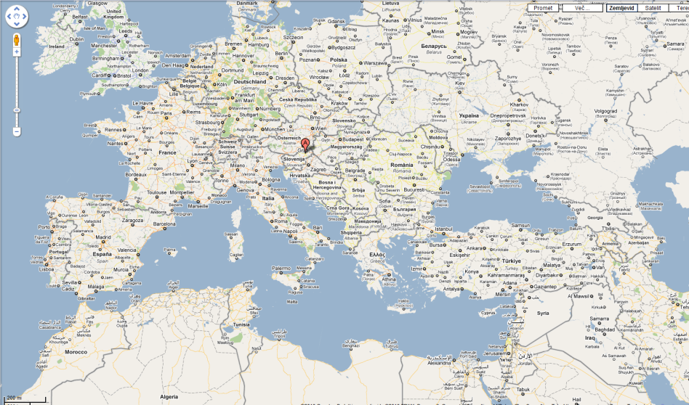
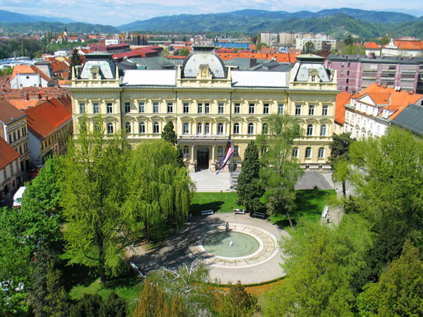
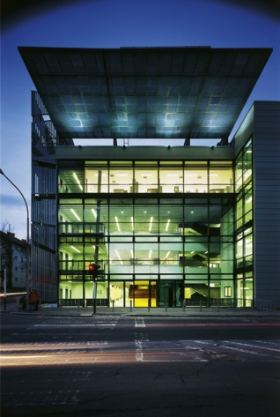
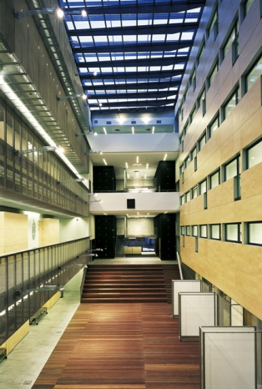
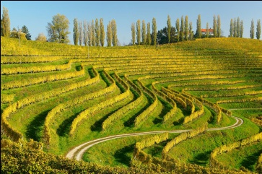



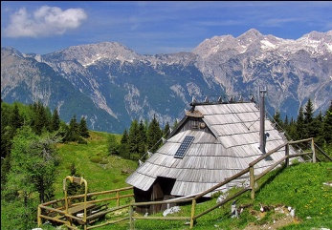


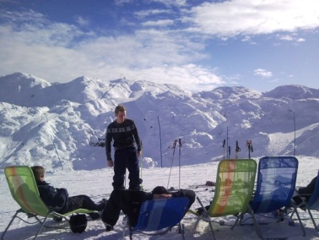
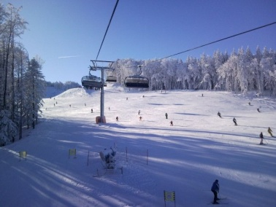
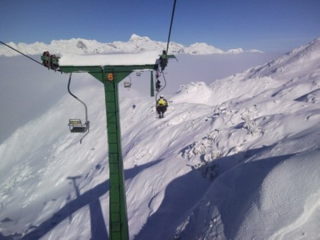
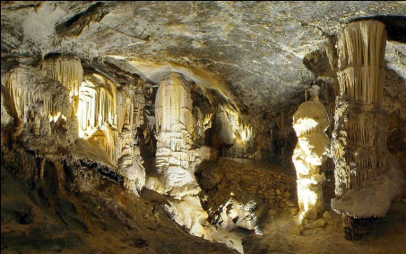
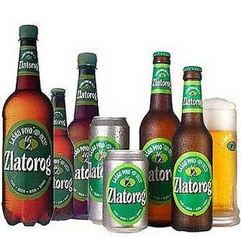
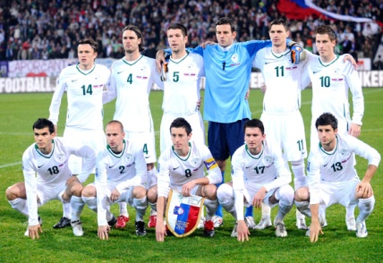


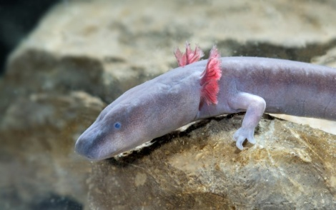
Thank you for your attention!
Faculty of
Electrical Engineering
and Computer Science
University of Maribor
I FEEL SLOVENIA

